Slide 1


Slide 2
Session 1
Life

Slide 3
Welcome and ‘Desert Island icebreaker’
What is the one thing that you could not survive without on a desert?

Slide 4
Life is…
How would you complete this sentence?

Slide 5
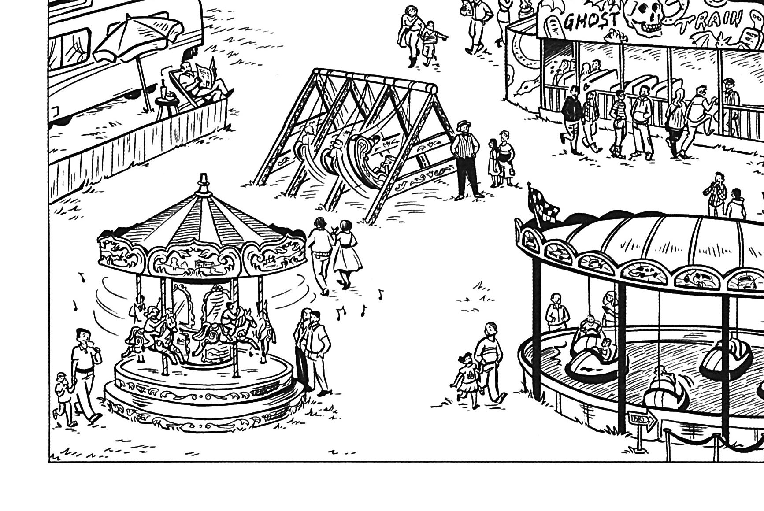
Ask people to imagine that the rides represent our lives. For example, the dodgems might represent us getting bumped around and taking knocks. Which fairground ride most represents their life right now?

Slide 6

Video Clip 1.1
Insert video clip 1.1 from your downloaded Start Digital (if you don’t have it downloaded you can buy it here) …then delete this text box!

Slide 7
Lifelines
In your manual (page 2) in the space provided draw a lifeline to represent your life so far. Make sure that you include the key moments of your life, both good and bad.
Good moments can be marked with a tick or smiling face, bad moments with a cross or sad face. Try and include at least four key moments.

Slide 8
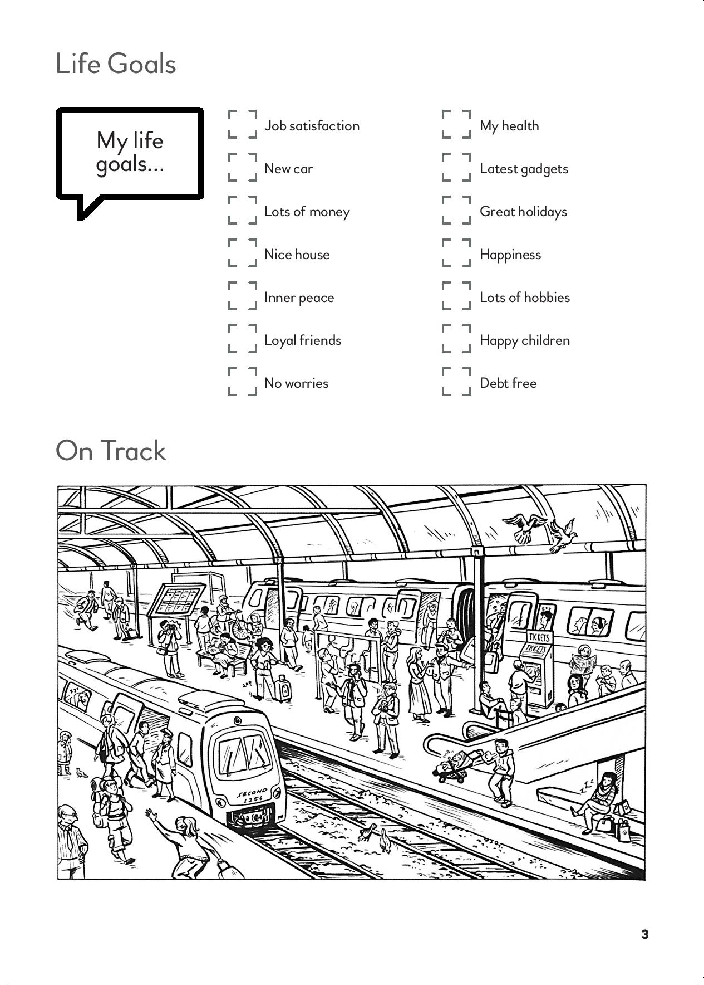
My life goals
Take a look at this list of life goals (also in your manual). Put them in order of how important they are to you. Alternatively, tick the THREE that are most important for them in their lives.

Slide 9
Video Clip 1.2
Insert video clip 1.2 from your downloaded Start Digital (if you don’t have it downloaded you can buy it here) …then delete this text box!

Slide 10
On track
If beginning with God is like setting out on a train journey, where would you say you are on this picture?

Slide 11
Video Clip 1.3
Insert video clip 1.3 from your downloaded Start Digital (if you don’t have it downloaded you can buy it here) …then delete this text box!

Slide 12
Reflection
Read the story of Zacchaeus from Luke 19.1-10. Then pray together:
Dear Lord God,
this is my life,
lived year by year,
and day by day,
May you help me to find the path,
the true path
that leads to true living.
Amen.

Slide 13
Take it away
There is a 'Take it away' section in your members' materials.
Before the next session, why not try thinking more about Psalm 139 which speaks powerfully about God's care and knowledge of us. There are suggestions for how to do this.

Slide 14
Session 2
God

Slide 15
Welcome and review
After the course leader has given a summary of the last session, why not share one two things from that session that struck you?

Slide 16
Video Clip 2.1
Insert video clip 2.1 from your downloaded Start Digital (if you don’t have it downloaded you can buy it here) …then delete this text box!

Slide 17
Dream ticket
Remember the picture of the train station in our last session? It introduced the idea that life can be seen as being like a journey.
Would you like to share with others about the worst journey you’ve ever had?
Discuss the perfect or dream journey. What would be:
The destination?
The means of travel?
Your companion/s?
Who goes with you on a journey makes a big difference to what it's like - and perhaps even whether you get there in the end.

Slide 18
Video Clip 2.2
Insert video clip 2.2 from your downloaded Start Digital (if you don’t have it downloaded you can buy it here) …then delete this text box!

Slide 19
For or against?
Ask group members for their initial reactions to what was said on the DVD.
Were there any ideas they particularly agreed with? Any they strongly disagreed with?

Slide 20
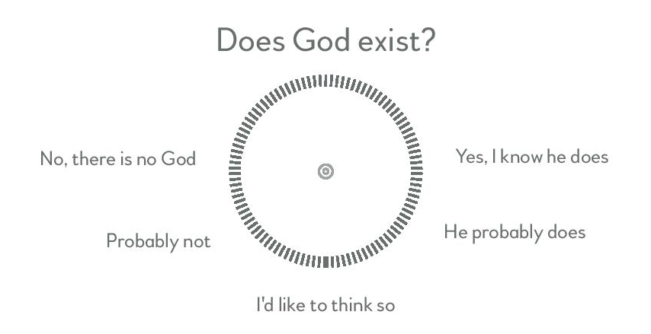
For or against?
Draw or imagine an arrow on your own ‘swingometer’ in the members' materials (p.5) to show how 'convinced’ you are by the arguments 'for' and 'against' God's existence.

Slide 21
In the picture
Think of a celebrity you know.
Once you have thought of someone, think of a sentence that would describe them.
Share with others.

Slide 22
In the picture
Now think of God
Come up with some words or a sentence to describe God
How did describing God compare with describing celebrities?

Slide 23
Welcome home
As we recap the story of the prodigal son, note that it is printed in your course materials.

Slide 24
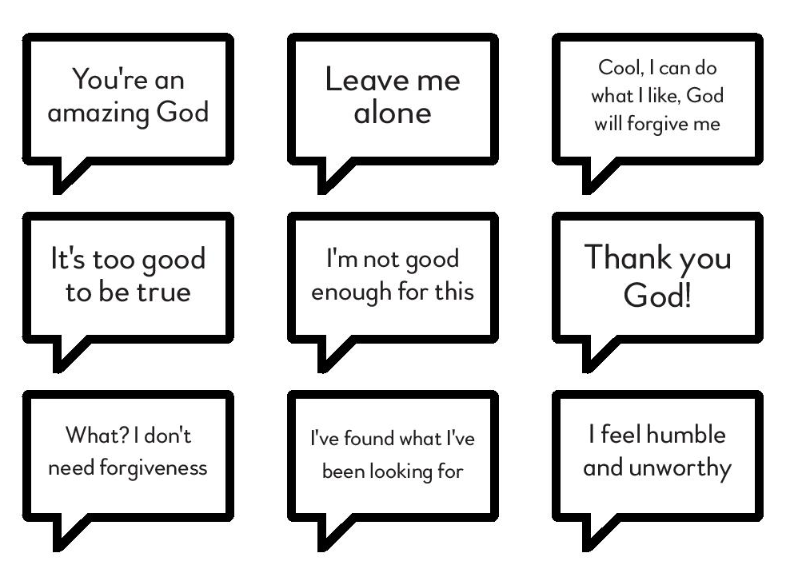
Welcome home
Which speech bubble most represents how you currently view God?

Slide 25
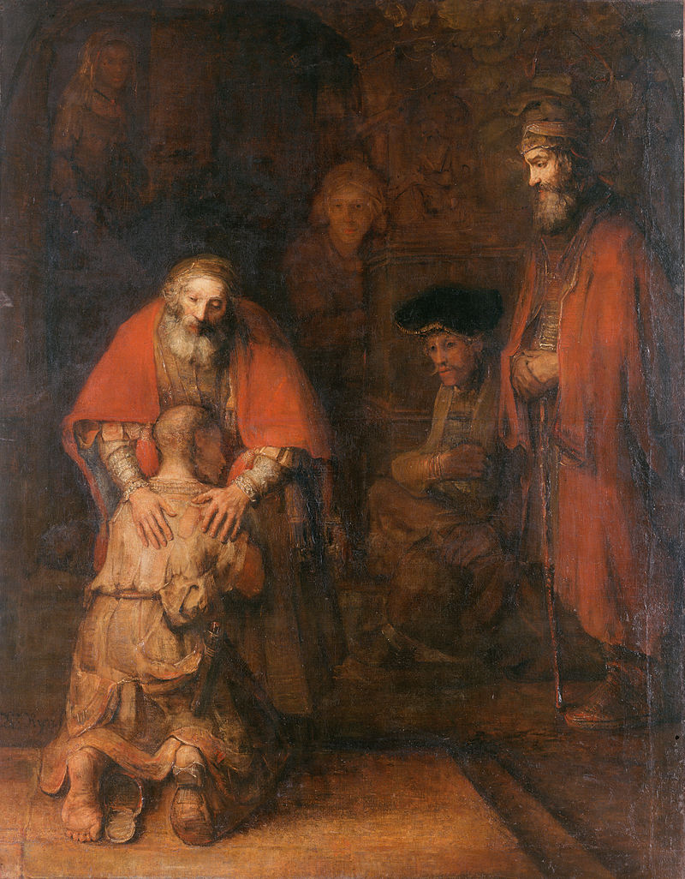
Welcome
home
‘The return of the prodigal son’ by Rembrandt

Slide 26
Video Clip 2.3
Insert video clip 2.3 from your downloaded Start Digital (if you don’t have it downloaded you can buy it here) …then delete this text box!

Slide 27
Reflection

Slide 28
Reflection
Heavenly Father,
Shepherd of the sheep.
You are the one who created all things,
and cares for us every day.
Help me to draw close to you,
to find faith in you,
and to live with you.
Amen.

Slide 29
Take it away
There is a 'Take it away' section in your members' materials.
Before the next session, spend a bit of time during the week thinking more about the Prodigal Son story. Consider where you are on the path towards God.

Slide 30
Session 3
Mess

Slide 31
Welcome and review
After the course leader has given a summary of the last session, why not share one two things from that session that struck you?
Was there anything from the ‘take it away’ thoughts and readings that inspired you?

Slide 32
Video Clip 3.1
Insert video clip 3.1 from your downloaded Start Digital (if you don’t have it downloaded you can buy it here) …then delete this text box!

Slide 33
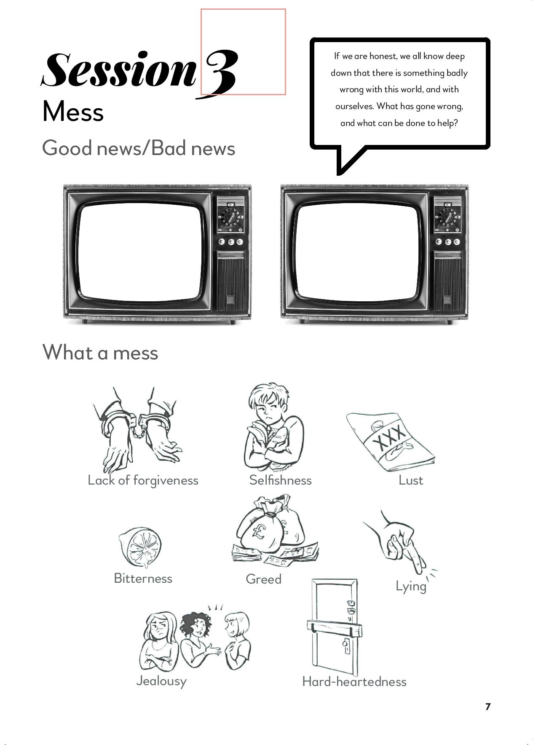
Good news/bad news
Think of one 'good news' headline and one 'bad news' headline that are in the news at the time that your group is meeting.
Write, or if people feel adventurous draw, those 'headlines' onto the TV screens (page 7 of your notes)

Slide 34
Video Clip 3.2
Insert video clip 3.2 from your downloaded Start Digital (if you don’t have it downloaded you can buy it here) …then delete this text box!

Slide 35
What a mess
Grade yourselves from 0 to 5 for the actions shown in the members' materials (page 7). Explain the scoring system: 0 = positively angelic; 5 = very, very bad.

Slide 36
Casting the first stone
Let’s think about the story of the woman caught in the act of adultery.
In the story we see Jesus writing in the sand with his finger (we don't know what he actually wrote). Imagine that Jesus was writing a message to you. What do you think it would say? Write that message on the sand image in the members' materials (page .

Slide 37
Video Clip 3.3
Insert video clip 3.3 from your downloaded Start Digital (if you don’t have it downloaded you can buy it here) …then delete this text box!

Slide 38

Reflection
Focus on the message you wrote in the members' booklet for the sand image exercise.
After a time of quiet, read Psalm 51.10-12 and 15-17.

Slide 39
Reflection
Dear Lord and heavenly Father,
we thank you for all
that is good in our life.
For people, for our daily bread,
for joys and satisfactions.
But we have to confess
that which is not good.
Words spoken, deeds done,
love forgotten,
Hurts done to us,
Hurts that we have done to others.
May you help us to find a new
and better way to live.
Amen.

Slide 40
Take it away
There is a 'Take it away' section in your members' materials.
Before the next session, meditate over Psalm 51, emphasising that God overflows with grace and mercy to all who come to him with their brokenness. The group may also want to look again at the 'What a mess' exercise from this week..

Slide 41
Session 4
Jesus

Slide 42
Welcome and review
Was there anything from the ‘take it away’ thoughts and readings that inspired you?

Slide 43
Heroes
Take a minute to answer the question: 'Who is your hero?’
Explain that this can be an actual person they know in real life, someone they've seen on TV or in the news, or even a fictional character from literature or a comic book!

Slide 44
Video Clip 4.1
Insert video clip 4.1 from your downloaded Start Digital (if you don’t have it downloaded you can buy it here) …then delete this text box!

Slide 45
All about Jesus
Think of words to describe as many aspects as possible of Jesus' life and character.
Here are some questions that may help:
What do you think Jesus looked like?
What do we know about his birth?
Can you remember how he died?
Jesus often told stories - can you think of any?
Who were some of the people Jesus met?

Slide 46
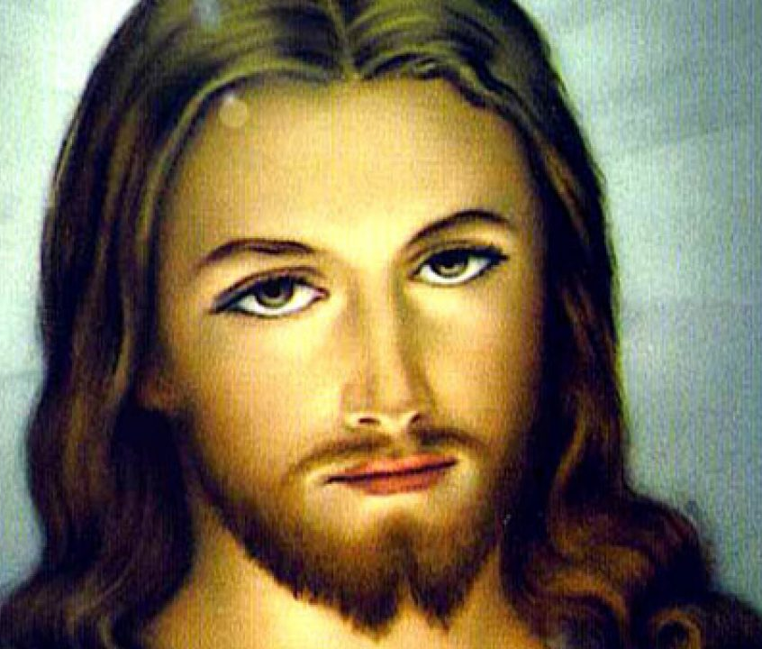
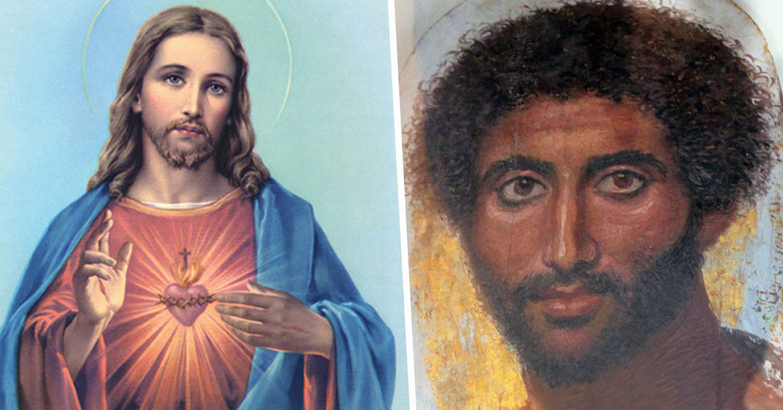
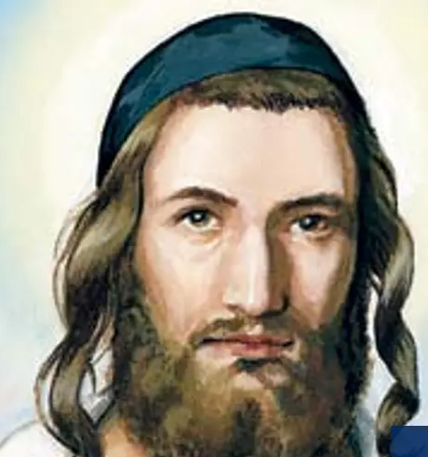
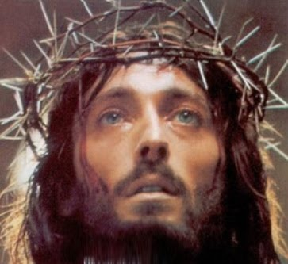
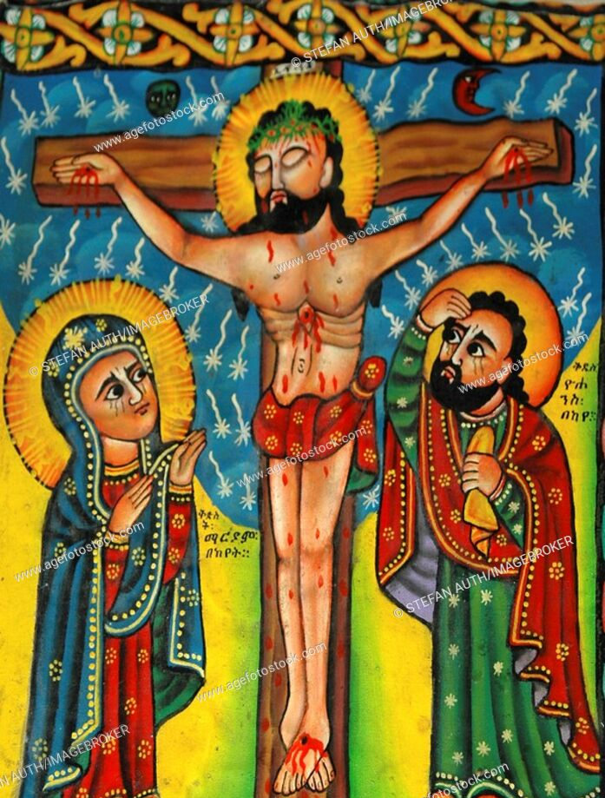
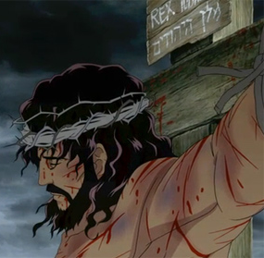
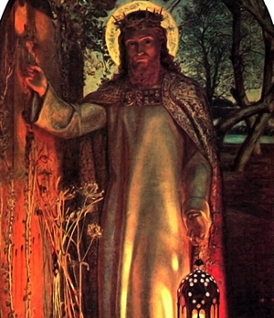
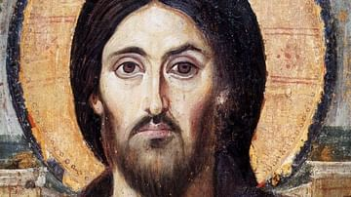
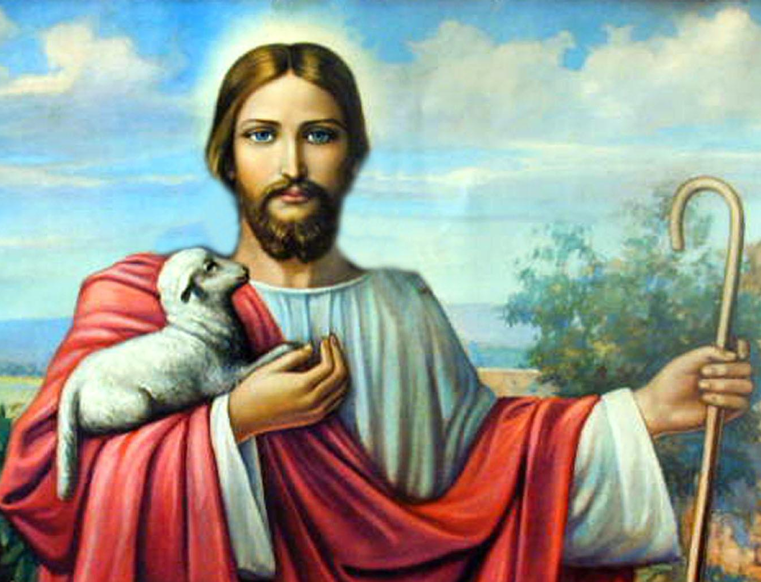
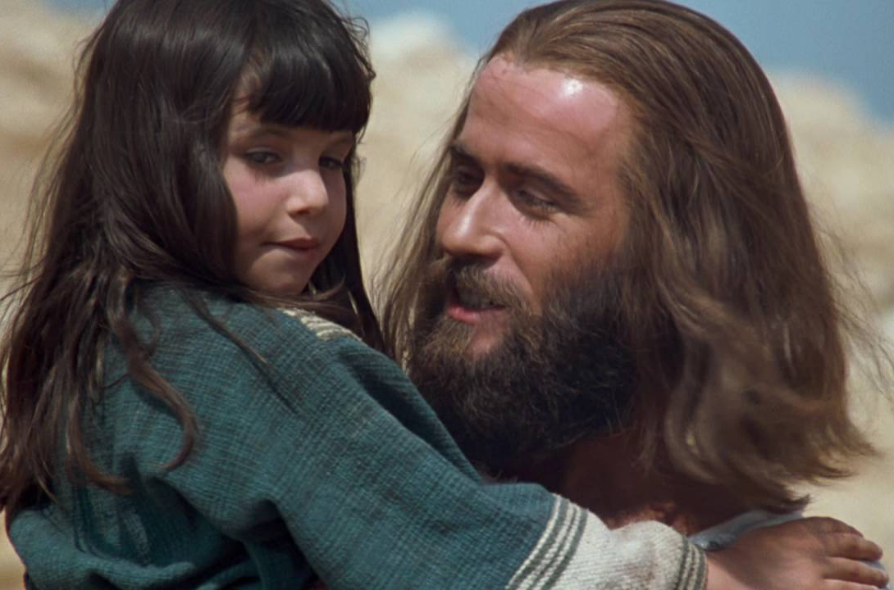
Pictures of Jesus

Slide 47
Video Clip 4.2
Insert video clip 4.2 from your downloaded Start Digital (if you don’t have it downloaded you can buy it here) …then delete this text box!

Slide 48
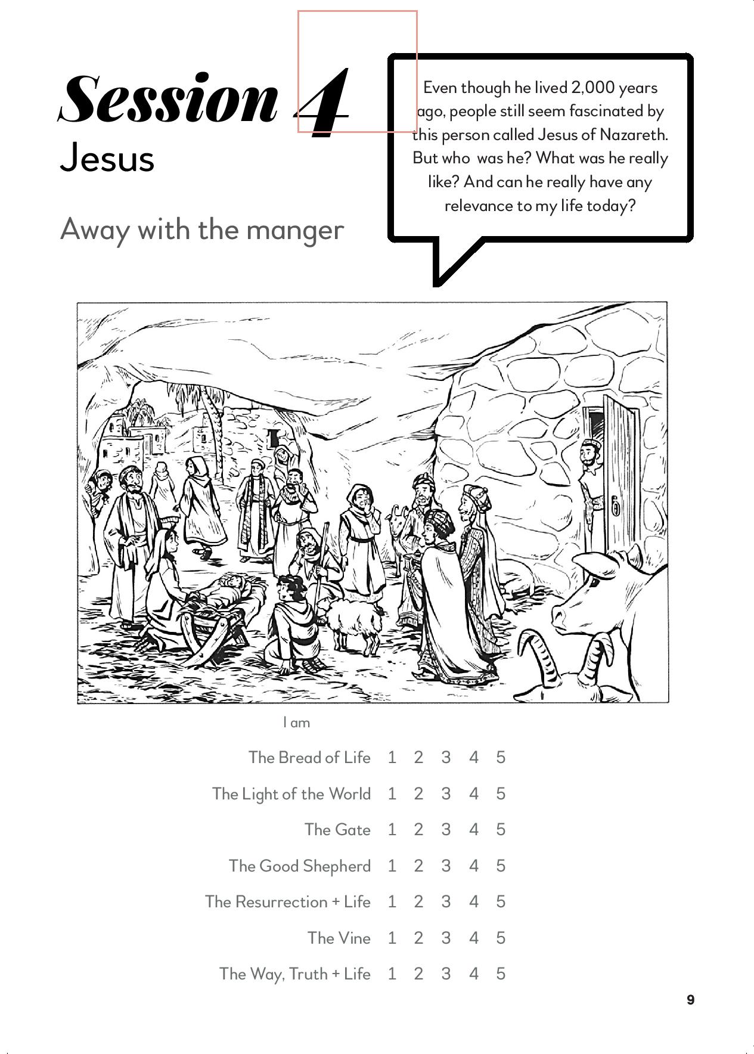
Away with the manger
Which of the characters best represents how we feel about Jesus right now? Draw a circle around the character that is most like us (page 9).

Slide 49
I am
On a scale of 1 to 5 (where 5 is high) score how true you think each 'I am' saying is for you right now when it comes to thinking about Jesus (page 9)

Slide 50
Video Clip 4.3
Insert video clip 4.3 from your downloaded Start Digital (if you don’t have it downloaded you can buy it here) …then delete this text box!

Slide 51
Reflection

Slide 52
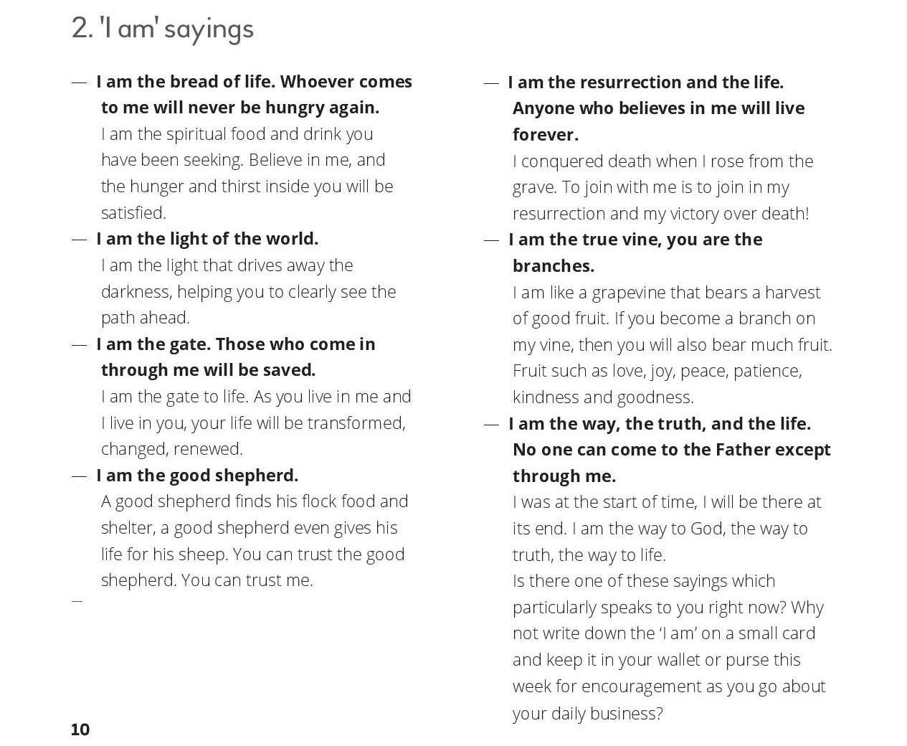
Reflection

Slide 53
Reflection
Jesus,
the way, the truth and the life,
the light, the bread, the vine
the gateway and the Good Shepherd.
Help us to see you more clearly,
follow you more nearly,
and love you more dearly,
every day.
Amen.

Slide 54
Take it away
The 'I am' sayings are listed there for further reflection during the week.
Why not continue to think about those powerful and challenging sayings during the week.
You can also complete the speech bubble exercise.

Slide 55
Session 5
Cross

Slide 56
Welcome and review
Was there anything from the ‘take it away’ thoughts and readings that inspired you?

Slide 57
Best things
Start with either of these icebreaker questions:
What's the best thing anyone has ever done for you?
What is the best present that anyone has ever given to you?
Follow up by discussing this question: Why do you think that person did that for you?

Slide 58
Video Clip 5.1
Insert video clip 5.1 from your downloaded Start Digital (if you don’t have it downloaded you can buy it here) …then delete this text box!

Slide 59
Cross worship
Do you know of a worship song or hymn that specifically focuses on Jesus' death? Perhaps you have a favourite.
Suitable songs available in most hymn books include:
There is a green hill far away
When I survey the wondrous cross
From heaven you came
The cross has said it all
My Lord, what love is this? (Amazing Love)
You might be able to play one from YouTube here.

Slide 60
Video Clip 5.2
Insert video clip 5.2 from your downloaded Start Digital (if you don’t have it downloaded you can buy it here) …then delete this text box!

Slide 61
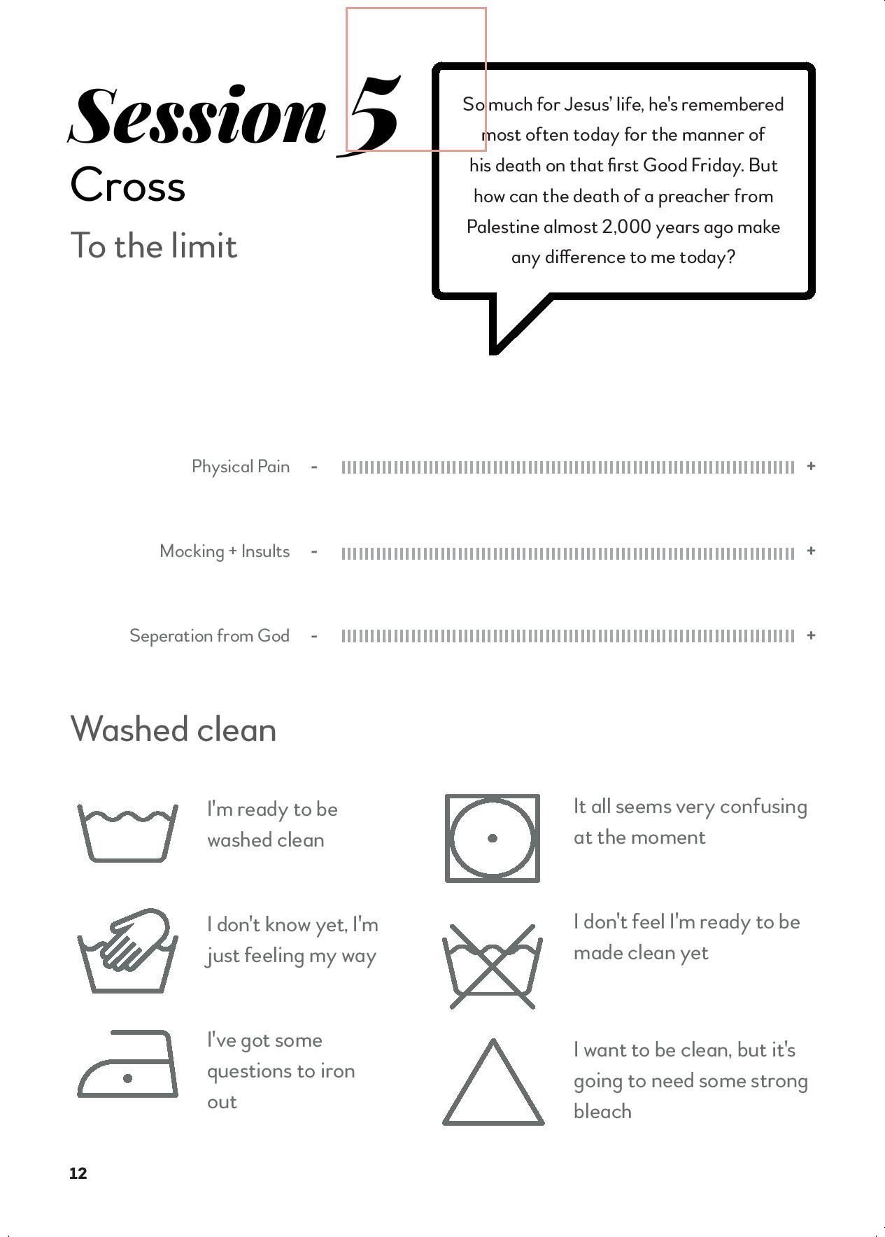
To the limit
Consider aspects of Jesus' suffering mentioned on the video clip. These are also listed in the members' materials (page 12).
Have a moment for people to consider individually which of these caused Jesus the greatest distress.

Slide 62
Washed clean
Look at the 'washed clean' exercise in the course members' materials (page 12).
This is an opportunity to make an assessment of where we think they are right now. Circle the response that seems closest to where they are now.

Slide 63
Video Clip 5.3
Insert video clip 5.3 from your downloaded Start Digital (if you don’t have it downloaded you can buy it here) …then delete this text box!

Slide 64
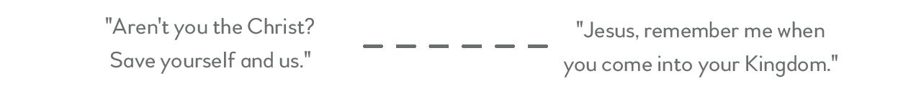
The two thieves
Look at the scale printed in the booklet (p.13) and place an 'X' on the line to signify where you think you fit between the two extremes expressed. We are specifically referring here to the idea that we will enter into eternal life (or not!) with Jesus.
Talk more as a group about the resurrection. Explore questions such as:
What reasons might we have to not believe in a resurrection?
What difference would it make to us to know for sure that we can live forever with God?
How do we feel about the promise of resurrection?

Slide 65
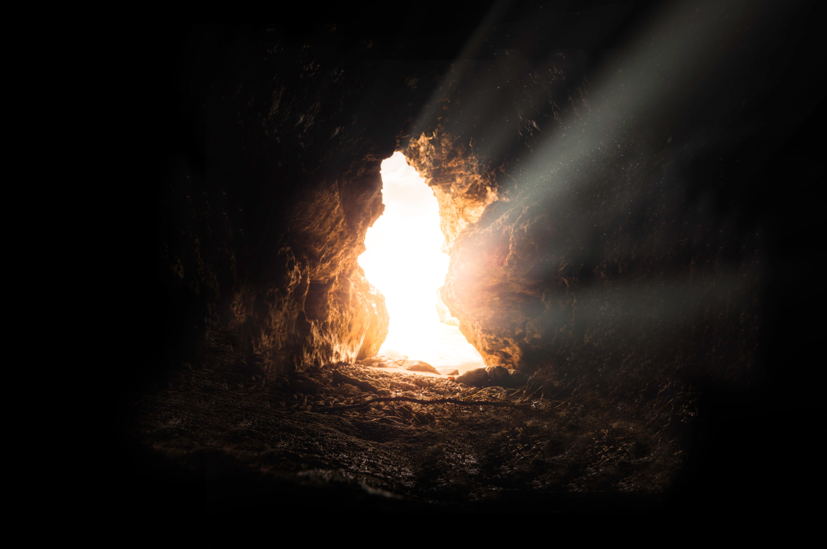
Reflection

Slide 66
Reflection
Lord Jesus,
when I survey the wondrous cross
I see you.
I see pain.
I see love.
I see painful love reaching out to me.
Help me to kneel before your cross,
to gaze in wonder
and to accept.
Amen.

Slide 67
Take it away
Encourage people to think some more about the two thieves story. Reflect again on the laundry label exercise.
There are also some questions to consider based on Jesus' words on the cross from Luke 23:34-36.

Slide 68
Session 6
Onwards

Slide 69
Welcome and review
Was there anything from the ‘take it away’ thoughts and readings that inspired you?

Slide 70
Video Clip 6.1
Insert video clip 6.1 from your downloaded Start Digital (if you don’t have it downloaded you can buy it here) …then delete this text box!

Slide 71
Back on track
Look again at the railway station picture on the members' notes (p.3)
We asked:
If beginning with God is like setting out on a train journey, where would you say you are on this picture?
Remember where you placed yourselves?
Has anything changed in the last six weeks?

Slide 72
Video Clip 6.2
Insert video clip 6.2 from your downloaded Start Digital (if you don’t have it downloaded you can buy it here) …then delete this text box!

Slide 73
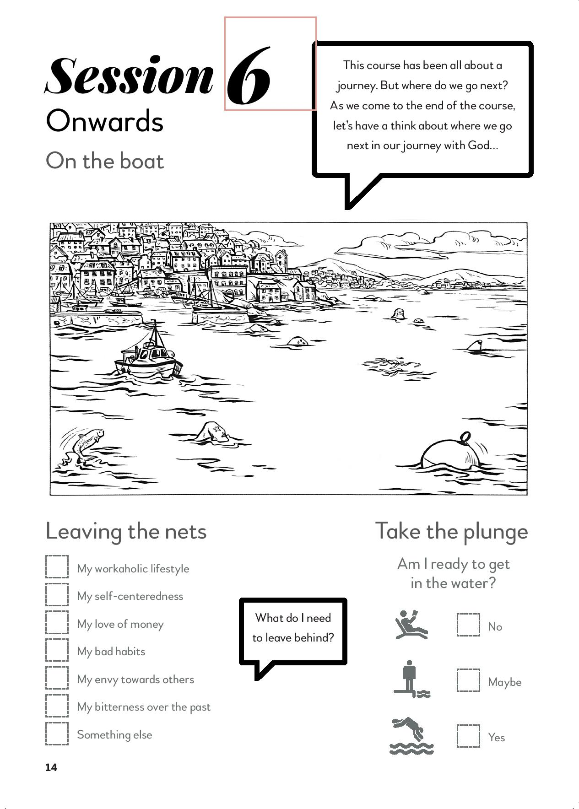
On the boat
Look at the boat exercise in the members' materials (p.14).
Looking at that picture, where would we place ourselves right now, as we come to the end of this Start course?

Slide 74
Leaving the nets
In the members' materials (p.14) you’ll see a list of the kinds of things that, typically, we might need to leave behind. There’s also a space to add in others. Consider the list and tick any which apply to them.

Slide 75
Video Clip 6.3
Insert video clip 6.3 from your downloaded Start Digital (if you don’t have it downloaded you can buy it here) …then delete this text box!

Slide 76
Take the plunge
Look at the swimming pool symbols in the members' materials (p.14) .
Respond privately by choosing one of those options.

Slide 77
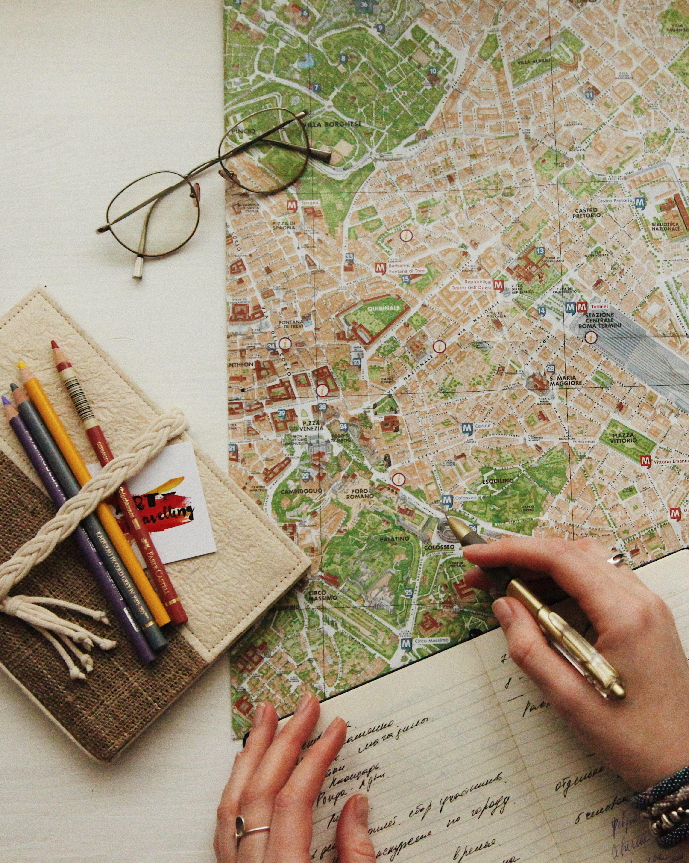
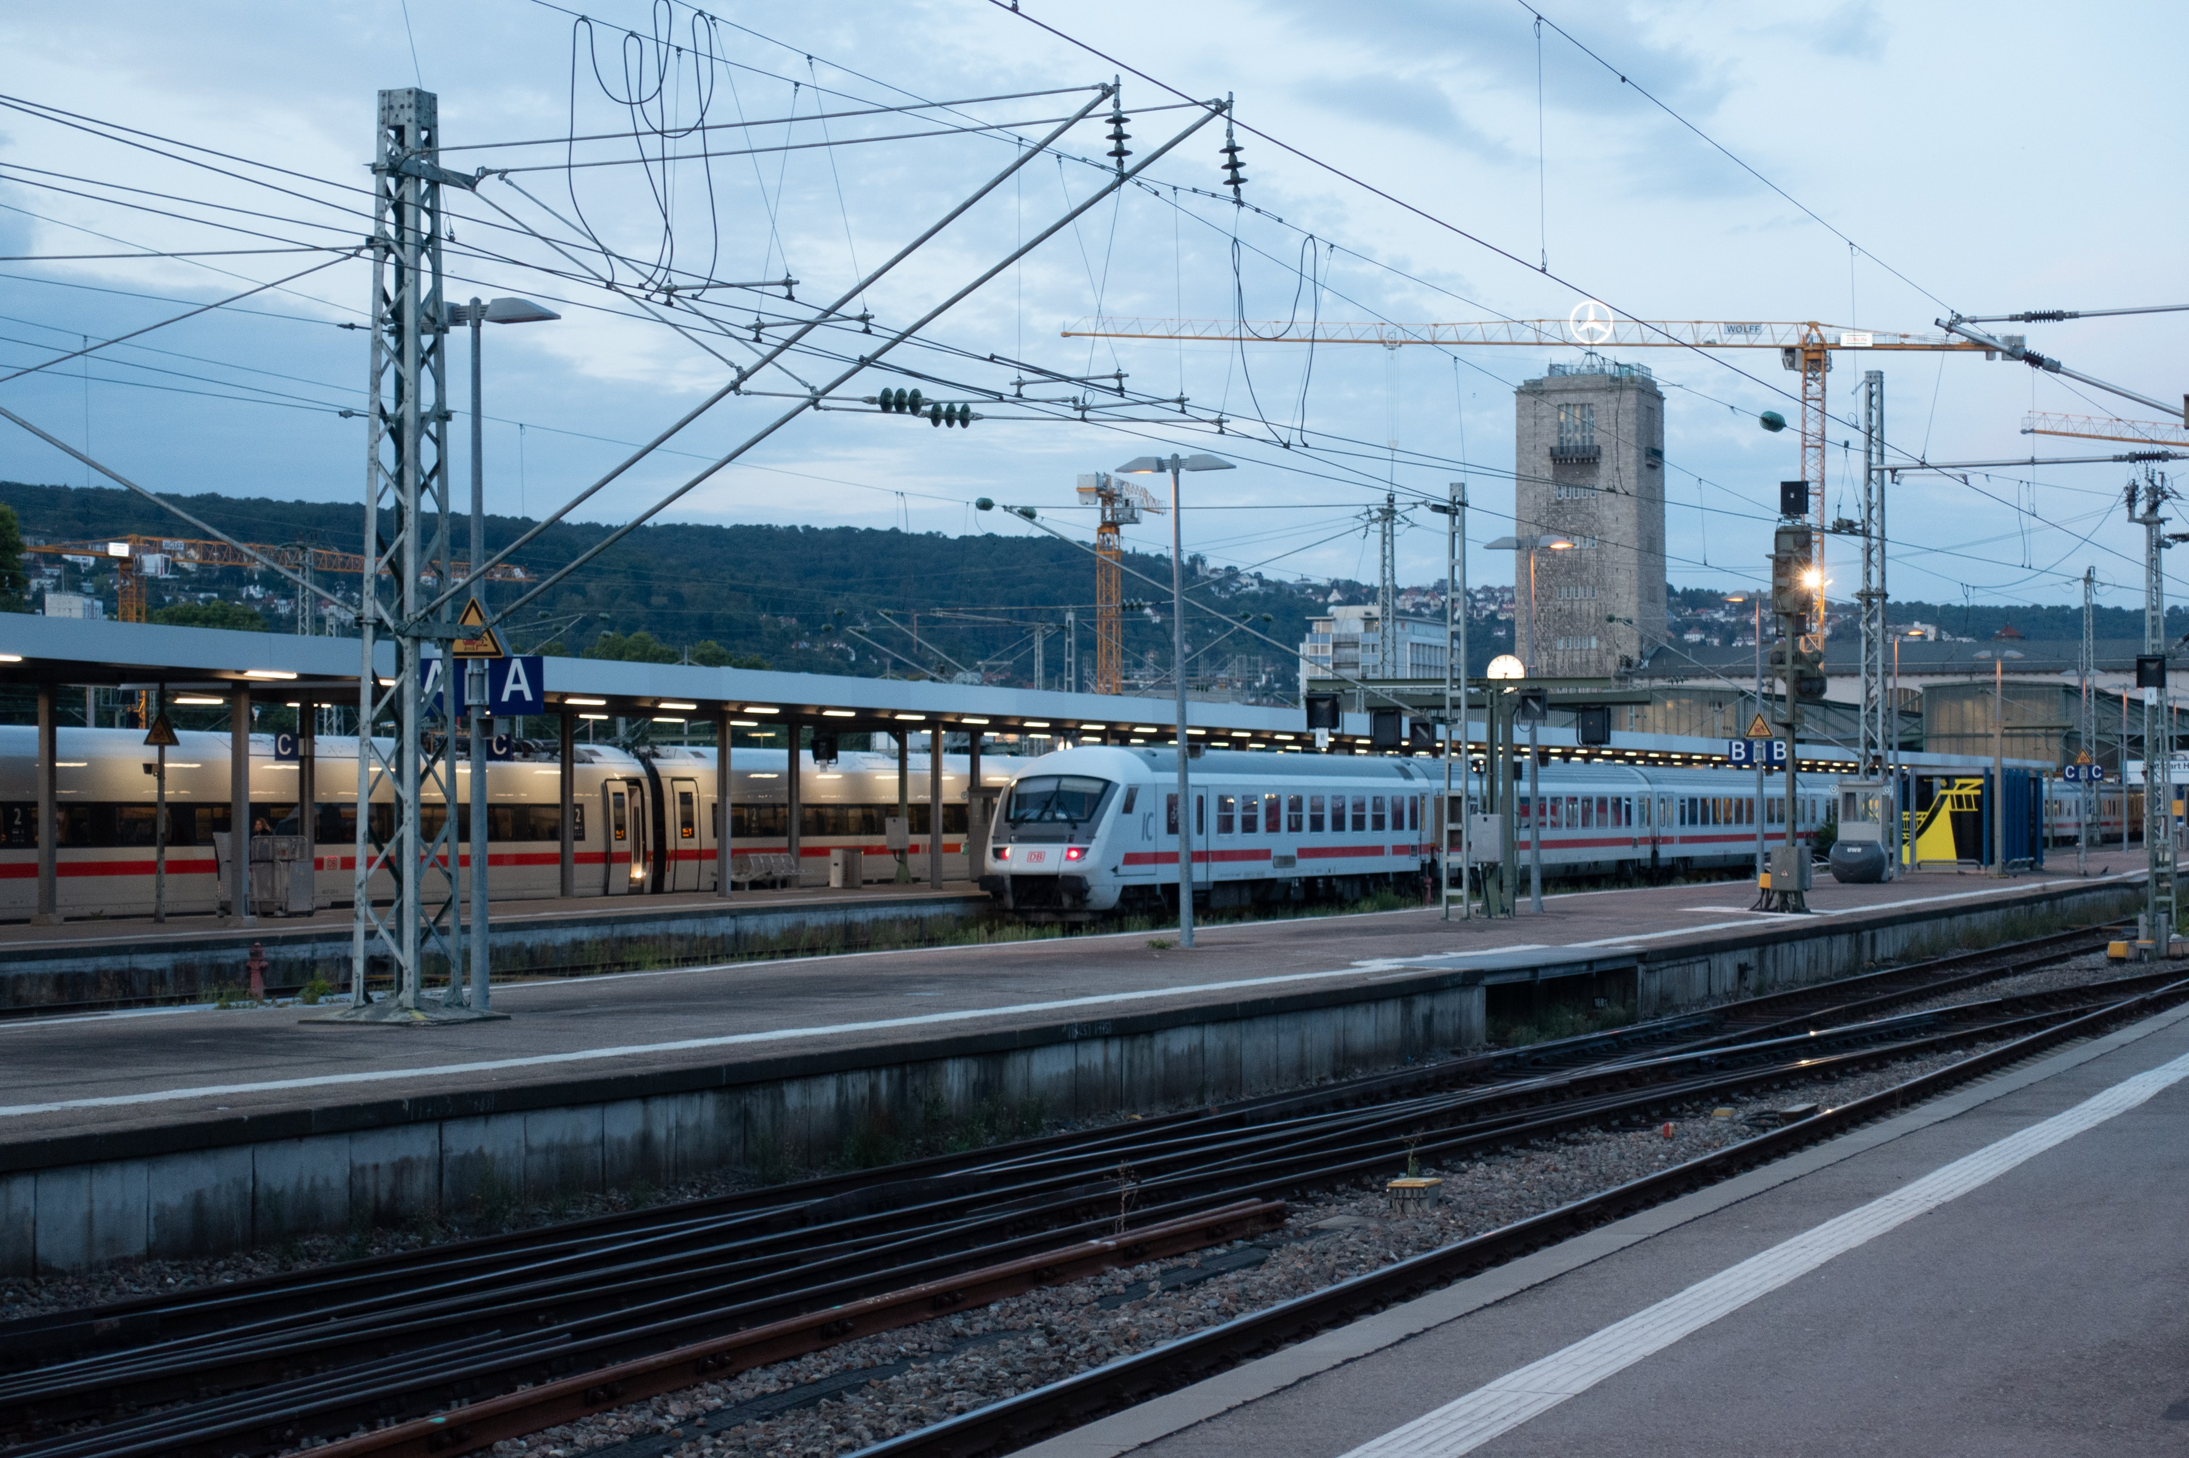
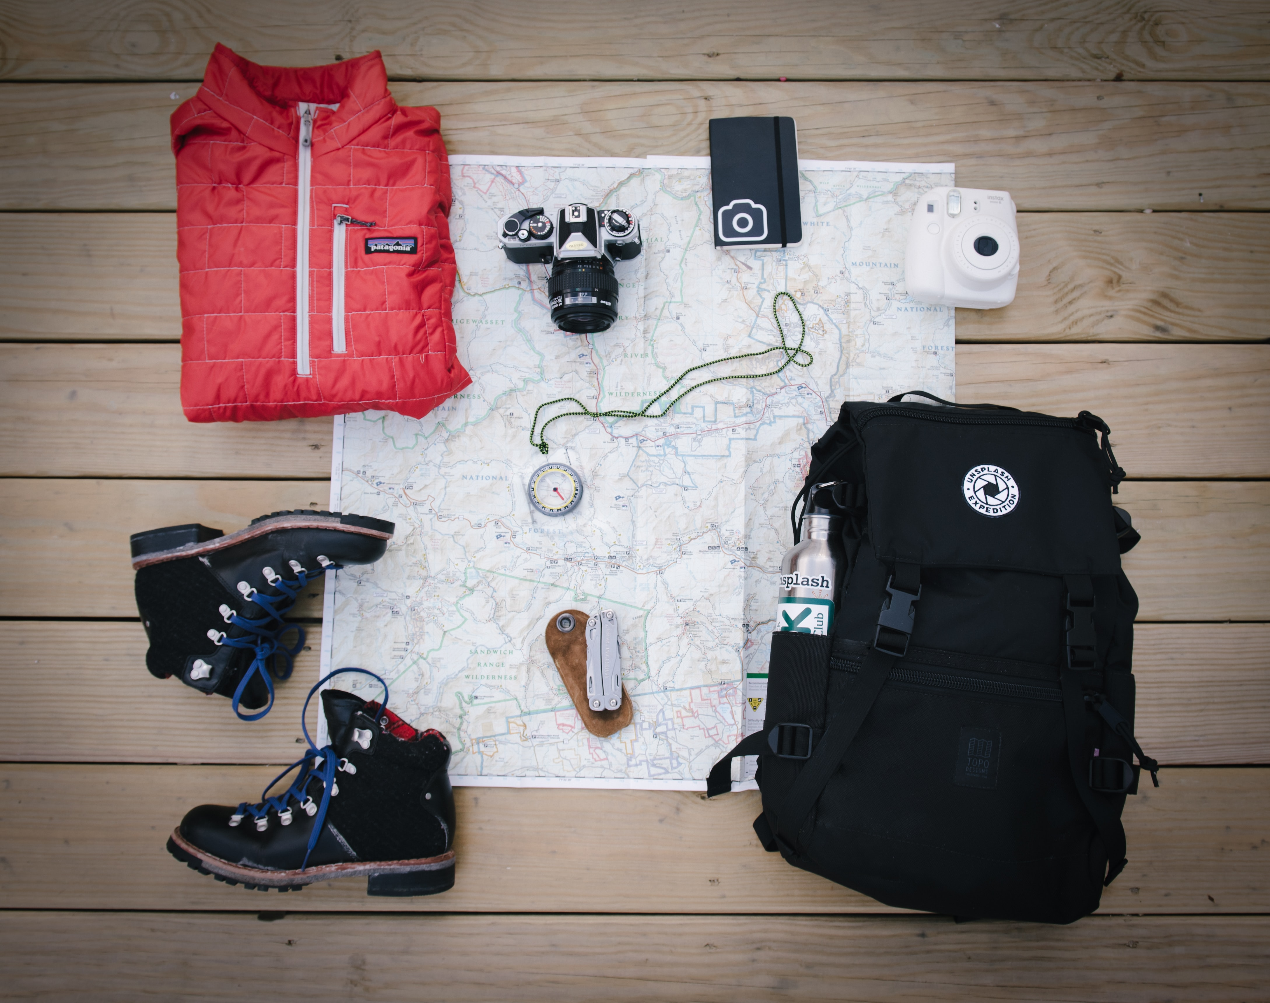

Reflection

Slide 78
Reflection
Heavenly Father,
you were there when I started this life.
Be there now as I start afresh,
as I say sorry for all my sin,
Yes to Jesus,
Hello to my new brothers and sisters.
As I start a new life
With you, and for you and following you.
Amen.

Slide 79
Take it away
Encourage the group to fill in The Next Step activity.
They also have the prayer for the week and the passage from Mark 1:16-20 to meditate on.
Could Jesus be calling them to follow him?

